Slide 1
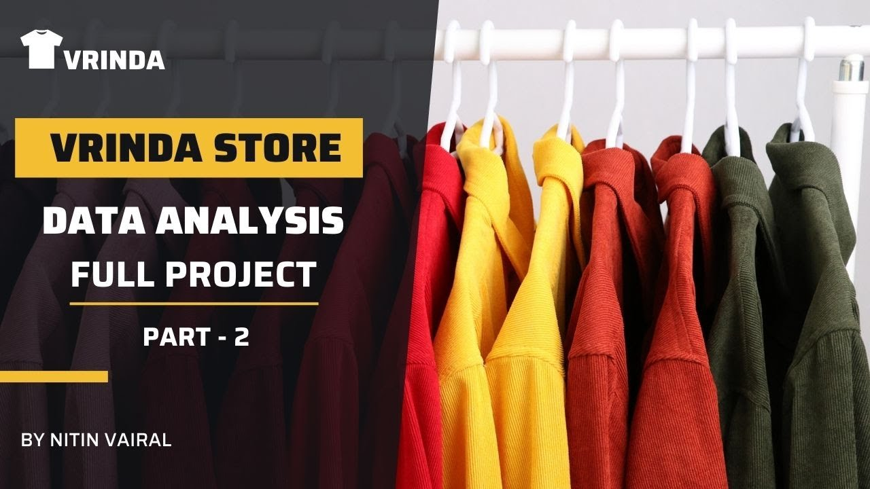
VRINDA STORE REPORT 2022

Slide 2
Interpretation
Amazon, Myntra, and Flipkart channels are contributing to Max (~90%).
92% of orders have Delivered Status.
March month has the highest count of orders.
The Adult age group (30 to 49) has contributed to Max (~50%).
Women are more likely to purchase compared to Men (~64%).
Maharashtra, Karnataka, and Uttar Pradesh are the Top 3 states are contributed Max Sales

Slide 3
Conclusion
To Improve Vrinda Store Sales in 2023 :
Target the women customers of the adult age group living in Maharashtra, Karnataka, and Uttar Pradesh states.
Launch different sales/ads/coupons in the month of March.
Improved status of orders.

